Slide 1

Analysis of the Effect of Home Advantage on Wins in EPL
Name: Shourya Sankha Mishra
Roll no: 472

Slide 2

Home Advantage
A brief introduction

Slide 3
What is Home Advantage?
The consistent finding that home teams in sports competitions win over 50% of the games played under a balanced home and away schedule.
The notion of home advantage hypothesises that the game location factors feed into the psychological states of the players, coaches and officials so as to impact the behaviour of these individuals resulting in advantage for the home team.

Slide 4
Possible reasons behind Home Advantage
Influence of crowd & Referee Bias
Travel Fatigue
Location Familiarity

Slide 5

Methodology
Procedure & Analyses

Slide 6
Procedure
The following table shows the data collected for the season 2008-09. Each of the serial numbers denote the ith team in the league table. The Home and Away columns give the total points scored by the ith team in their home and away games respectively.
Data on the consecutive ten seasons from 2008-09 to 2017-18 has been collected in the similar fashion.
08-09 | 1 | 2 | 3 | 4 | 5 | 6 | 7 | 8 | 9 | 10 | 11 | 12 | 13 | 14 | 15 | 16 | 17 | 18 | 19 | 20
Home | 50 | 43 | 39 | 39 | 38 | 36 | 35 | 35 | 30 | 30 | 29 | 29 | 27 | 26 | 25 | 24 | 24 | 22 | 21 | 14
Away | 40 | 43 | 11 | 44 | 34 | 17 | 16 | 10 | 33 | 32 | 22 | 16 | 14 | 15 | 16 | 8 | 8 | 12 | 15 | 21

Slide 7
Analyses
Normality tests
For every home and away series of data for ten different seasons (20 in total), Shapiro-Wilks test for normality is carried out to check whether they are drawn from normal population or not.
Test for difference of means
For each of the paired data samples appropriate tests for the significant difference of means is carried out (Paired t-test for bivariate normal samples and non parametric Median test for the rest). Further, let us define a matrix $X^{10×20}=(\left(x_{ij}\right))$, where $x_{ij}$ denotes the index for the $j$th ranked team in the $i$th season, $i=1\left(1\right)10, j=1\left(1\right)20$.
For each of the paired data samples appropriate tests for the significant difference of means is carried out (Paired t-test for bivariate normal samples and non parametric Median test for the rest). Further, let us define a matrix 𝑋^(10×20)=((𝑥_𝑖𝑗 )), where 𝑥_𝑖𝑗 denotes the index for the 𝑗th ranked team in the 𝑖th season, 𝑖=1(1)10, 𝑗=1(1)20.
Time trends
We shall plot the ${\overline{x_{io}}}^{′}$s with the subsequent seasons to observe how the effect of home advantage behaves over time.
We shall plot the (𝑥_𝑖𝑜 ) ̅^′s with the subsequent seasons to observe how the effect of home advantage behaves over time.
Team ability
To find out how home advantage affects teams of different abilities, we shall plot the $\overline{x_{oj}}′$s against finishing positions (1 to 20).
To find out how home advantage affects teams of different abilities, we shall plot the (𝑥_𝑜𝑗 ) ̅′s against finishing positions (1 to 20).

Slide 8
Table showing Home-Advantage indices of Seasons versus Finishing positions
 | 1 | 2 | 3 | 4 | 5 | 6 | 7 | 8 | 9 | 10 | 11 | 12 | 13 | 14 | 15 | 16 | 17 | 18 | 19 | 20
2008-09 | 55.6 | 50.0 | 47.0 | 52.8 | 47.6 | 48.4 | 67.9 | 68.6 | 56.9 | 78.0 | 77.8 | 64.4 | 65.9 | 63.4 | 61.0 | 58.3 | 40.0 | 64.7 | 75.0 | 75.0
2009-10 | 60.5 | 57.6 | 62.7 | 62.9 | 59.7 | 50.0 | 66.7 | 63.9 | 72.0 | 66.0 | 57.4 | 78.3 | 77.3 | 61.5 | 55.3 | 69.4 | 74.3 | 86.7 | 80.0 | 90.0
2010-11 | 68.8 | 63.4 | 60.6 | 54.4 | 58.1 | 69.0 | 63.0 | 63.3 | 64.6 | 63.8 | 55.3 | 76.1 | 73.9 | 56.5 | 65.1 | 54.8 | 70.0 | 66.7 | 51.3 | 60.6
2011-12 | 61.8 | 52.8 | 57.1 | 60.9 | 58.5 | 60.9 | 58.9 | 67.3 | 51.9 | 66.0 | 57.4 | 44.7 | 64.4 | 62.2 | 51.2 | 50.0 | 70.3 | 44.4 | 61.3 | 48.0
2012-13 | 53.9 | 57.7 | 54.7 | 52.1 | 52.8 | 66.7 | 54.1 | 63.3 | 71.7 | 56.5 | 70.5 | 55.8 | 66.7 | 68.3 | 61.0 | 48.8 | 59.0 | 50.0 | 71.4 | 56.0
2013-14 | 60.5 | 58.3 | 58.5 | 55.7 | 58.3 | 52.2 | 46.9 | 53.6 | 72.0 | 55.1 | 60.0 | 54.8 | 60.0 | 55.3 | 47.4 | 67.6 | 58.3 | 72.7 | 56.3 | 66.7
2014-15 | 56.3 | 57.0 | 54.7 | 62.9 | 51.6 | 56.5 | 61.7 | 57.1 | 61.1 | 43.8 | 66.0 | 59.6 | 56.8 | 63.4 | 66.7 | 55.3 | 52.6 | 57.1 | 57.6 | 76.7
2015-16 | 51.9 | 56.3 | 51.4 | 62.1 | 57.6 | 57.1 | 54.8 | 53.3 | 54.9 | 48.0 | 63.8 | 48.9 | 53.3 | 53.5 | 50.0 | 47.6 | 61.5 | 75.7 | 67.6 | 64.7
2016-17 | 54.8 | 61.6 | 51.3 | 53.9 | 60.0 | 49.3 | 70.5 | 67.4 | 52.2 | 64.4 | 55.6 | 77.3 | 61.4 | 65.9 | 48.8 | 82.5 | 70.0 | 82.4 | 64.3 | 58.3
2017-18 | 50.0 | 58.0 | 55.8 | 57.3 | 52.9 | 74.6 | 48.1 | 69.4 | 57.4 | 63.6 | 59.1 | 59.1 | 64.3 | 65.9 | 72.5 | 62.2 | 52.8 | 63.6 | 60.6 | 58.1

Slide 9

Results
Statistical tests & Graphical plots

Slide 10
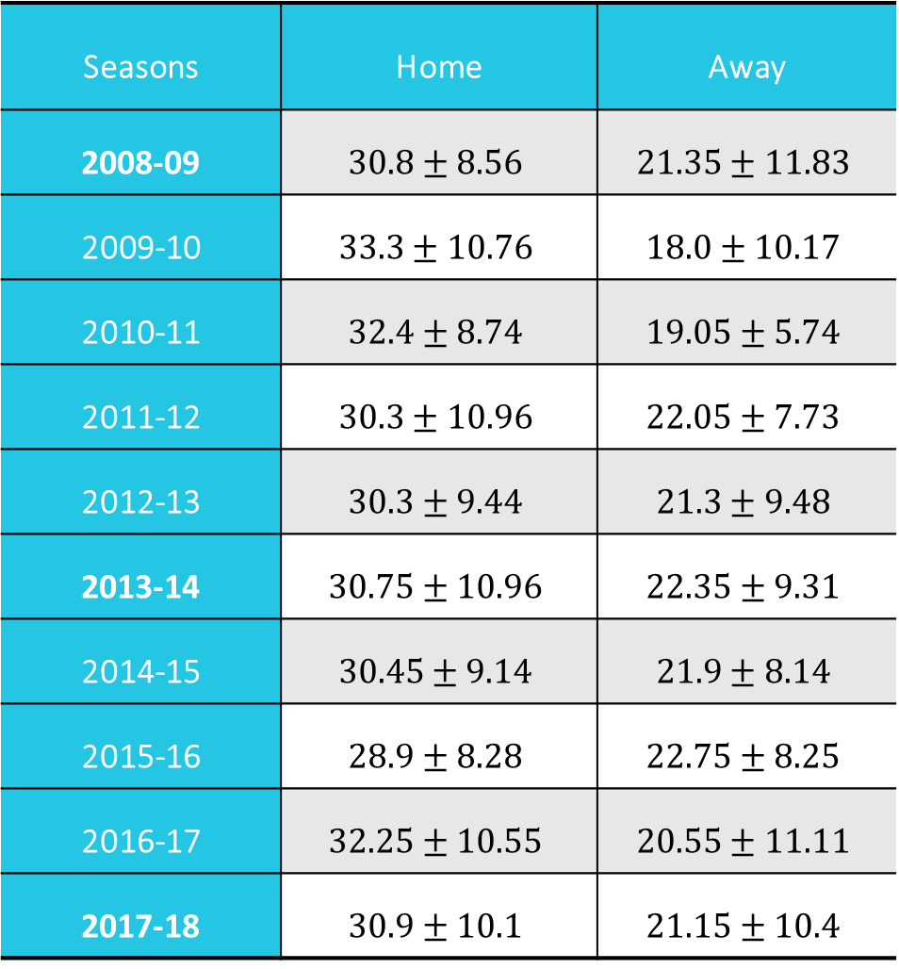
Data Summary
Seasons | Home | Away
2008-09 | $$30.8±8.56$$ | $$21.35±11.83$$
2009-10 | $$33.3±10.76$$ | $$18.0±10.17$$
2010-11 | $$32.4±8.74$$ | $$19.05±5.74$$
2011-12 | $$30.3±10.96$$ | $$22.05±7.73$$
2012-13 | $$30.3±9.44$$ | $$21.3±9.48$$
2013-14 | $$30.75±10.96$$ | $$22.35±9.31$$
2014-15 | $$30.45±9.14$$ | $$21.9±8.14$$
2015-16 | $$28.9±8.28$$ | $$22.75±8.25$$
2016-17 | $$32.25±10.55$$ | $$20.55±11.11$$
2017-18 | $$30.9±10.1$$ | $$21.15±10.4$$
The adjacent table gives a brief summary of the data under analysis, namely the means and standard deviations of the home and away points for each season.
It can be observed that the home means are greater than away means for all of the ten seasons.

Slide 12
Tables showing the results of the Shapiro-Wilks test
Season | Samples | p-value of Shapiro-Wilk test | Decision
2008-09 | 08-09 home | 0.9409 | Accept | ______
 | 08-09 away | 0.0087 | Reject
2009-10 | 09-10 home | 0.8516 | Accept | Bivariate normal sample
 | 09-10 away | 0.7633 | Accept
2010-11 | 10-11 home | 0.3584 | Accept | Bivariate normal sample
 | 10-11 away | 0.2979 | Accept
2011-12 | 11-12 home | 0.9277 | Accept | Bivariate normal sample
 | 11-12 away | 0.3603 | Accept
2012-13 | 12-13 home | 0.8697 | Accept | Bivariate normal sample
 | 12-13 away | 0.0587 | Accept
Season | Samples | p-value of Shapiro-Wilk test | Decision
2013-14 | 13-14 home | 0.0302 | Reject | ______
 | 13-14 away | 0.0204 | Reject
2014-15 | 14-15 home | 0.1589 | Accept | Bivariate normal sample
 | 14-15 away | 0.6972 | Accept
2015-16 | 15-16 home | 0.3788 | Accept | Bivariate normal sample
 | 15-16 away | 0.8812 | Accept
2016-17 | 16-17 home | 0.7184 | Accept | Bivariate normal sample
 | 16-17 away | 0.0793 | Accept
2017-18 | 17-18 home | 0.0269 | Reject | ______
 | 17-18 away | 0.0011 | Reject

Slide 13
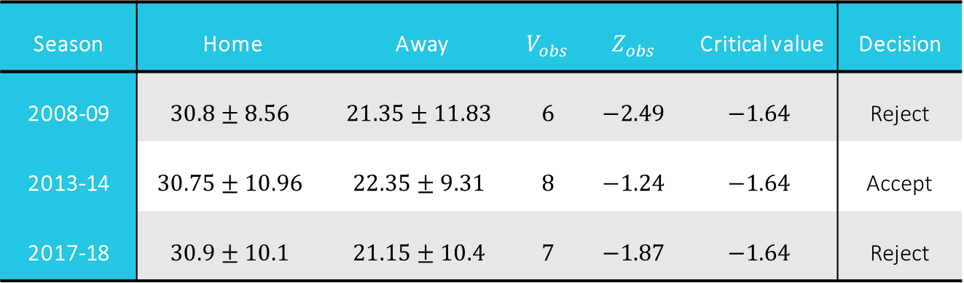

Median tests
We consider home points as the first sample and away points as the second sample for each season. Let $V$ denote the number of first sample observations which are $<X_{me}$. Then $Z=[ V$-E($V$) $]$/ s.d($V$) follows a standard normal distribution. We reject the null hypothesis iff $Z_{obs}< −τ_{α}$.
The following table gives the results of the median tests carried out in the analysis.
Season | Home | Away | $$V_{obs}$$ | $$Z_{obs}$$ | Critical value | Decision
2008-09 | $$30.8±8.56$$ | $$21.35±11.83$$ | $$6$$ | $$−2.49$$ | $$−1.64$$ | Reject
2013-14 | $$30.75±10.96$$ | $$22.35±9.31$$ | $$8$$ | $$−1.24$$ | $$−1.64$$ | Accept
2017-18 | $$30.9±10.1$$ | $$21.15±10.4$$ | $$7$$ | $$−1.87$$ | $$−1.64$$ | Reject

Slide 14
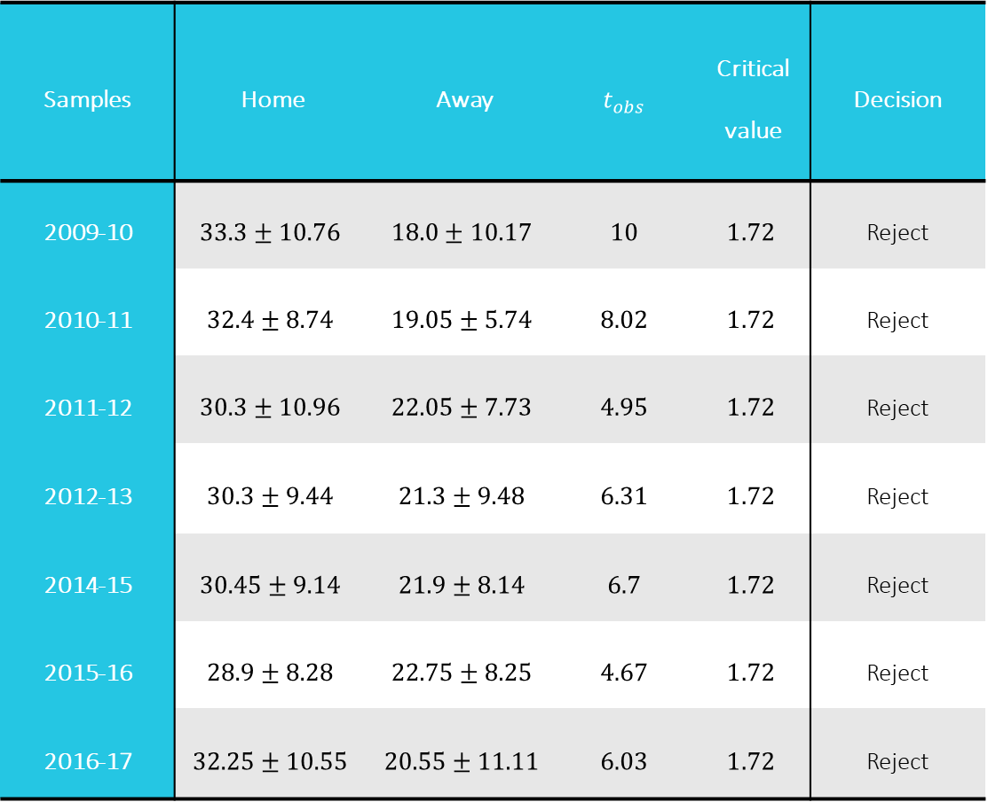
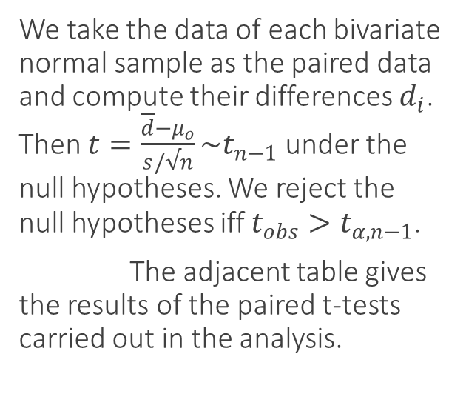
Paired t-tests
Samples | Home | Away | $$t_{obs}$$ | Critical value | Decision
2009-10 | $$33.3±10.76$$ | $$18.0±10.17$$ | $$10$$ | $$1.72$$ | Reject
2010-11 | $$32.4±8.74$$ | $$19.05±5.74$$ | $$8.02$$ | $$1.72$$ | Reject
2011-12 | $$30.3±10.96$$ | $$22.05±7.73$$ | $$4.95$$ | $$1.72$$ | Reject
2012-13 | $$30.3±9.44$$ | $$21.3±9.48$$ | $$6.31$$ | $$1.72$$ | Reject
2014-15 | $$30.45±9.14$$ | $$21.9±8.14$$ | $$6.7$$ | $$1.72$$ | Reject
2015-16 | $$28.9±8.28$$ | $$22.75±8.25$$ | $$4.67$$ | $$1.72$$ | Reject
2016-17 | $$32.25±10.55$$ | $$20.55±11.11$$ | $$6.03$$ | $$1.72$$ | Reject
We take the data of each bivariate normal sample as the paired data and compute their differences $d_{i}$. Then $t=\frac{\overline{d}−μ_{o}}{s/√n}\sim t_{n−1}$ under the null hypotheses. We reject the null hypotheses iff $t_{obs}>t_{α,n−1}$.
The adjacent table gives the results of the paired t-tests carried out in the analysis.

Slide 15
Figure showing the average home advantage indices w.r.t the finishing positions
Team ability:

Slide 16
Figure showing the average home advantage indices w.r.t each season
Time trends:

Slide 17
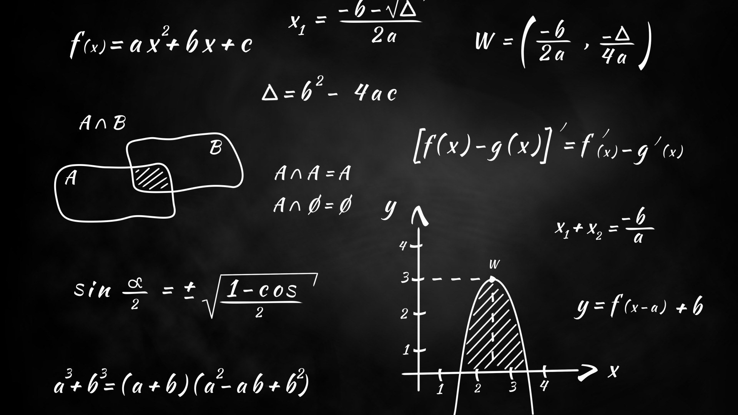
Conclusions

Slide 18



It is observed that out of the ten tests for difference of location conducted, nine of them have been rejected, implying that the points gathered by teams in their home games is significantly larger than that in away games. Thus, we arrive at the conclusion that teams are more successful in home fixtures than in away fixtures.
We conclude that teams of lower ability show home advantage to a greater extent than the teams of higher ability.
We also conclude that the home advantage in successive seasons do not exhibit any decreasing time trend and thus has remained relatively consistent in recent years.

Slide 19




Thank You
Shourya Sankha Mishra
shourya8114@gmail.com
St. Xavier’s College. Kolkata

